Slide 1

GRADUATE SCHOOL OF BUSINESS
Introduction to Machine Learning
Lecture 3 Fall 2019 Dmitry Udler
Notes:
1
1

Slide 2
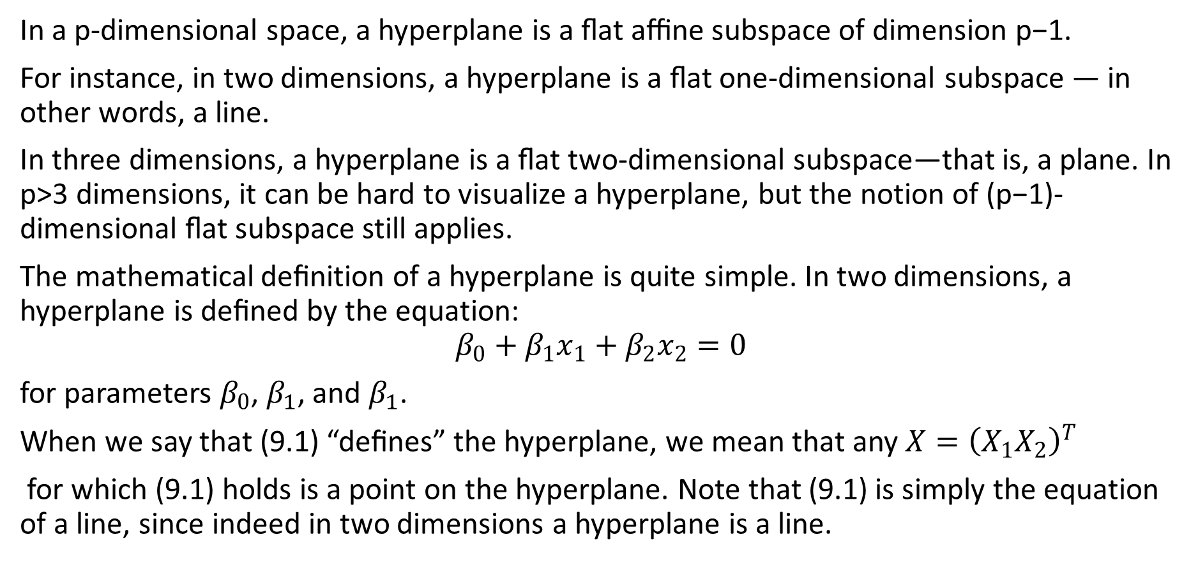
What is a hyperplane
In a p-dimensional space, a hyperplane is a ﬂat aﬃne subspace of dimension p−1.
For instance, in two dimensions, a hyperplane is a ﬂat one-dimensional subspace — in other words, a line.
In three dimensions, a hyperplane is a ﬂat two-dimensional subspace—that is, a plane. In p>3 dimensions, it can be hard to visualize a hyperplane, but the notion of (p−1)-dimensional ﬂat subspace still applies.
The mathematical deﬁnition of a hyperplane is quite simple. In two dimensions, a hyperplane is deﬁned by the equation:
$$β_{0}+β_{1}x_{1}+β_{2}x_{2}=0$$
for parameters $β_{0}$, $β_{1}$, and $β_{1}$.
When we say that (9.1) “deﬁnes” the hyperplane, we mean that any $X={\left(X_{1}X_{2}\right)}^{T}$
for which (9.1) holds is a point on the hyperplane. Note that (9.1) is simply the equation of a line, since indeed in two dimensions a hyperplane is a line.

Slide 3
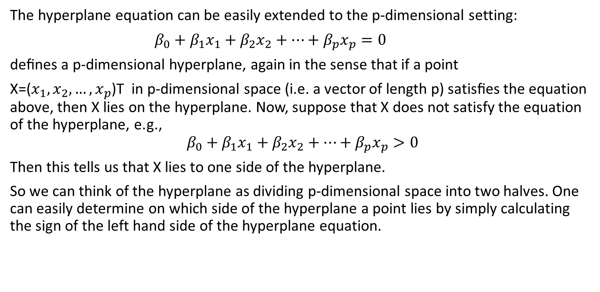
What is a hyperplane
The hyperplane equation can be easily extended to the p-dimensional setting:
$β_{0}+β_{1}x_{1}+β_{2}x_{2}+…+β_{p}x_{p}=0$
deﬁnes a p-dimensional hyperplane, again in the sense that if a point
X=($x_{1},x_{2},…, x_{p}$)T in p-dimensional space (i.e. a vector of length p) satisﬁes the equation above, then X lies on the hyperplane. Now, suppose that X does not satisfy the equation of the hyperplane, e.g.,
$$β_{0}+β_{1}x_{1}+β_{2}x_{2}+…+β_{p}x_{p}>0$$
Then this tells us that X lies to one side of the hyperplane.
So we can think of the hyperplane as dividing p-dimensional space into two halves. One can easily determine on which side of the hyperplane a point lies by simply calculating the sign of the left hand side of the hyperplane equation.

Slide 4
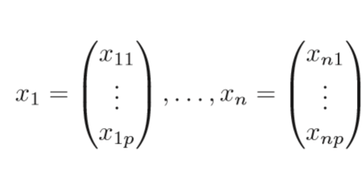
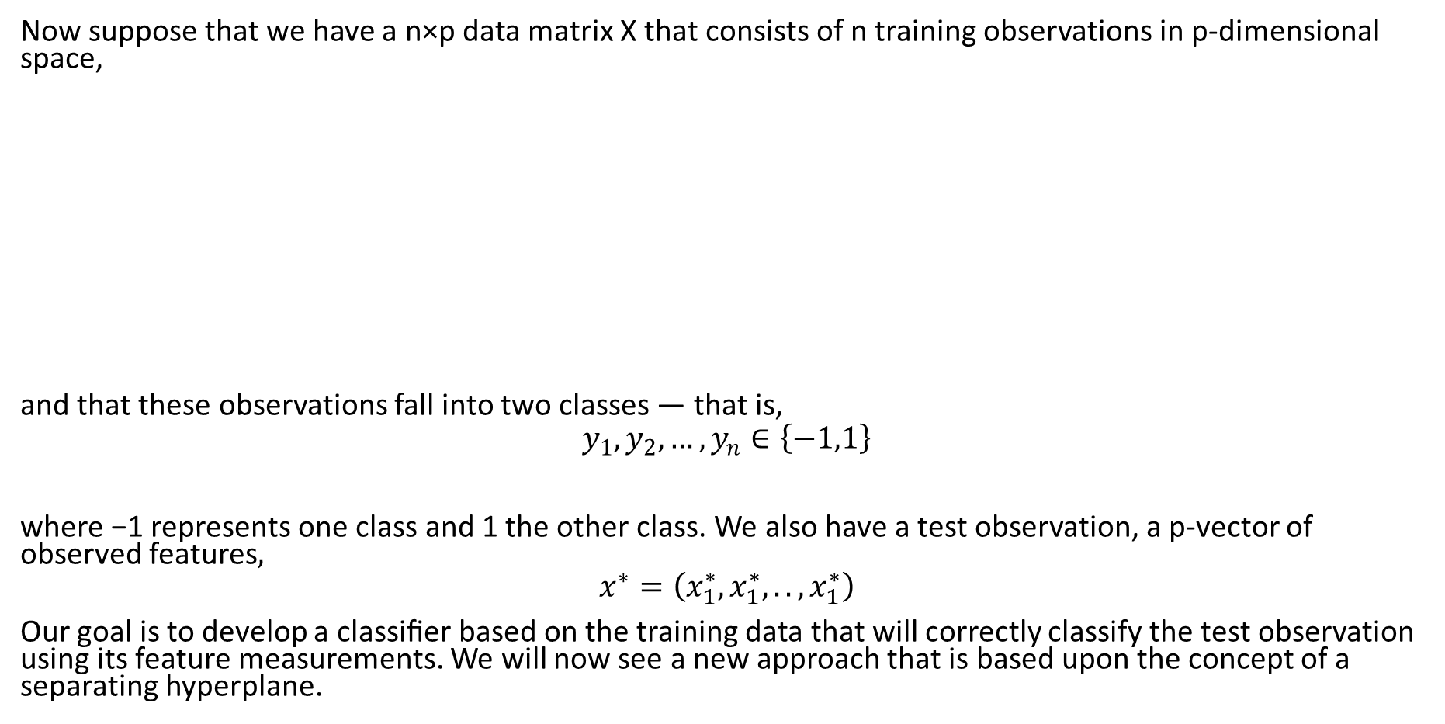
Classiﬁcation Using a Separating Hyperplane
Now suppose that we have a n×p data matrix X that consists of n training observations in p-dimensional space,
and that these observations fall into two classes — that is,
$$y_{1},y_{2},…,y_{n}∈\left\{−1,1\right\}$$
where −1 represents one class and 1 the other class. We also have a test observation, a p-vector of observed features$,$
$$x^{∗}=\left(x_{1}^{∗},x_{1}^{∗},..,x_{1}^{∗}\right)$$
Our goal is to develop a classiﬁer based on the training data that will correctly classify the test observation using its feature measurements. We will now see a new approach that is based upon the concept of a separating hyperplane.

Slide 5
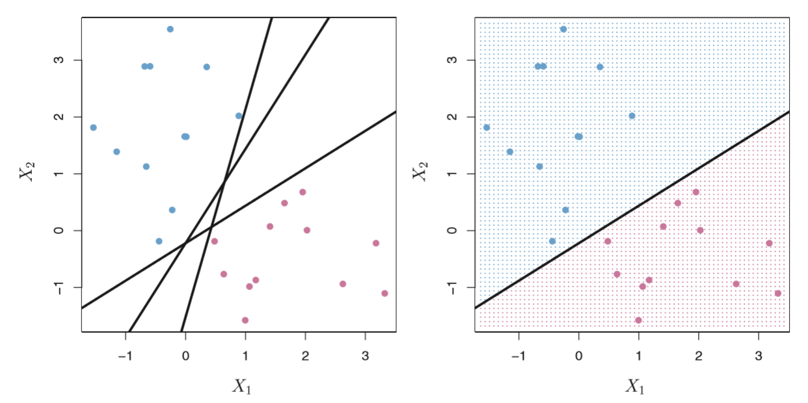
Classiﬁcation Using a Separating Hyperplane
Suppose that it is possible to construct a hyperplane that separates the training observations perfectly according to their class labels.

Slide 6
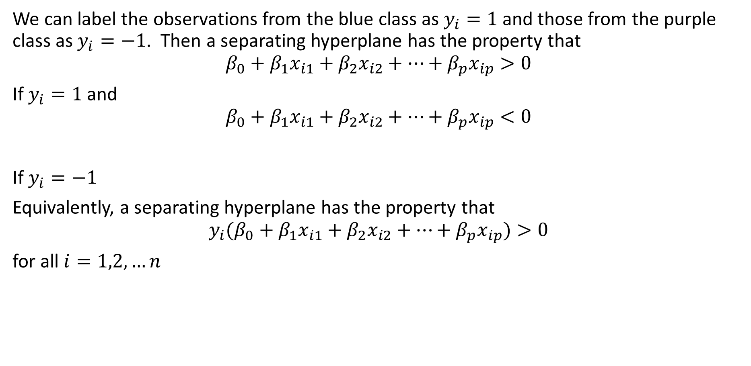
Classiﬁcation Using a Separating Hyperplane
We can label the observations from the blue class as $y_{i}=1$ and those from the purple class as $y_{i}=−1$. Then a separating hyperplane has the property that
$$β_{0}+β_{1}x_{i1}+β_{2}x_{i2}+…+β_{p}x_{ip}>0$$
If $y_{i}=1$ and
$$β_{0}+β_{1}x_{i1}+β_{2}x_{i2}+…+β_{p}x_{ip}<0$$
If $y_{i}=−1$
Equivalently, a separating hyperplane has the property that
$${y_{i}(β}_{0}+β_{1}x_{i1}+β_{2}x_{i2}+…+β_{p}x_{ip})>0$$
for all $i=1,2,…n$

Slide 7
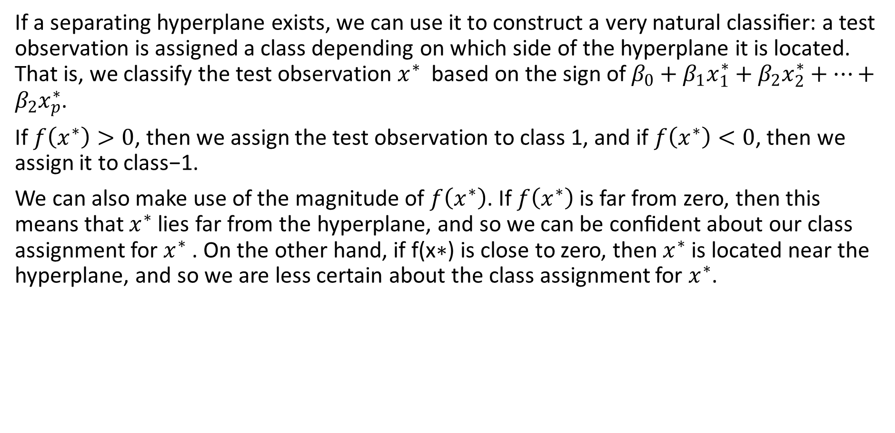
Classiﬁcation Using a Separating Hyperplane
If a separating hyperplane exists, we can use it to construct a very natural classiﬁer: a test observation is assigned a class depending on which side of the hyperplane it is located. That is, we classify the test observation $x^{∗}$ based on the sign of $β_{0}+β_{1}x_{1}^{∗}+β_{2}x_{2}^{∗}+…+β_{2}x_{p}^{∗}$.
If $f\left(x^{∗}\right)>0$, then we assign the test observation to class 1, and if $f\left(x^{∗}\right)<0$, then we assign it to class−1.
We can also make use of the magnitude of $f\left(x^{∗}\right)$. If $f\left(x^{∗}\right)$ is far from zero, then this means that $x^{∗}$ lies far from the hyperplane, and so we can be conﬁdent about our class assignment for $x^{∗}$ . On the other hand, if f(x∗) is close to zero, then $x^{∗}$ is located near the hyperplane, and so we are less certain about the class assignment for $x^{∗}$.

Slide 8
Classiﬁcation Using a Separating Hyperplane
In general, if our data can be perfectly separated using a hyperplane, then there will in fact exist an inﬁnite number of such hyperplanes. This is because a given separating hyperplane can usually be shifted a tiny bit up or down, or rotated, without coming into contact with any of the observations.
In order to construct a classiﬁer based upon a separating hyperplane, we must have a reasonable way to decide which of the inﬁnite possible separating hyperplanes to use.
A natural choice is the maximal margin hyperplane (also known as the optimal separating hyperplane), which is the separating hyperplane that is farthest from the training observations. That is, we can compute the (perpendicular) distance from each training observation to a given separating hyperplane; the smallest such distance is the minimal distance from the observations to the hyperplane, and is known as the margin.

Slide 9
Classiﬁcation Using a Separating Hyperplane
The maximal margin hyperplane is the separating hyperplane for which the margin is largest—that is, it is the hyperplane that has the farthest minimum distance to the training observations. We can then classify a test observation based on which side of the maximal margin hyperplane it lies. This is known as the maximal margin classiﬁer.
We hope that a classiﬁer that has a large margin on the training data will also have a large margin on the test data, and hence will classify the test observations correctly. Although the maximal margin classiﬁer is often successful, it can also lead to overﬁtting when p is large.

Slide 10
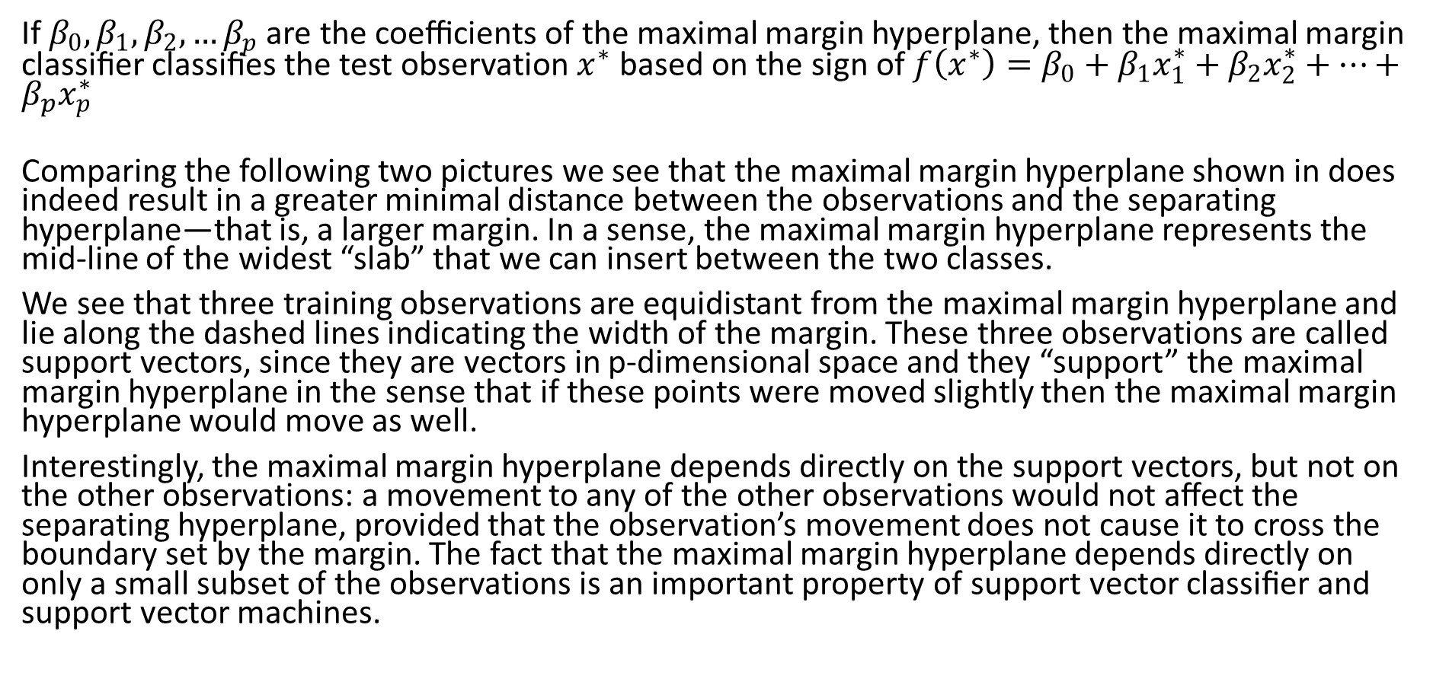
Classiﬁcation Using a Separating Hyperplane
If $β_{0},β_{1},β_{2},…β_{p}$ are the coeﬃcients of the maximal margin hyperplane, then the maximal margin classiﬁer classiﬁes the test observation $x^{∗}$ based on the sign of ${f\left(x^{∗}\right)=β}_{0}+β_{1}x_{1}^{∗}+β_{2}x_{2}^{∗}+…+β_{p}x_{p}^{∗}$
Comparing the following two pictures we see that the maximal margin hyperplane shown in does indeed result in a greater minimal distance between the observations and the separating hyperplane—that is, a larger margin. In a sense, the maximal margin hyperplane represents the mid-line of the widest “slab” that we can insert between the two classes.
We see that three training observations are equidistant from the maximal margin hyperplane and lie along the dashed lines indicating the width of the margin. These three observations are called support vectors, since they are vectors in p-dimensional space and they “support” the maximal margin hyperplane in the sense that if these points were moved slightly then the maximal margin hyperplane would move as well.
Interestingly, the maximal margin hyperplane depends directly on the support vectors, but not on the other observations: a movement to any of the other observations would not aﬀect the separating hyperplane, provided that the observation’s movement does not cause it to cross the boundary set by the margin. The fact that the maximal margin hyperplane depends directly on only a small subset of the observations is an important property of support vector classiﬁer and support vector machines.

Slide 11
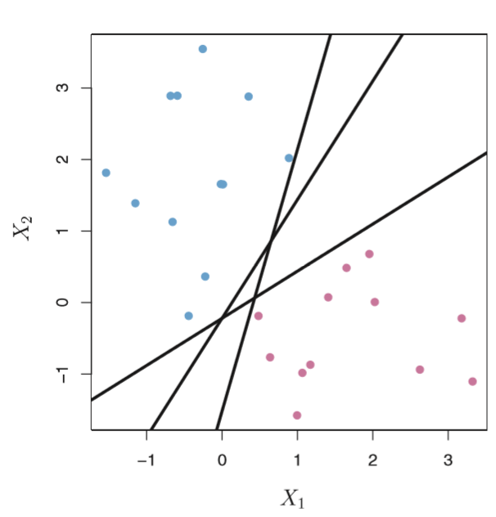
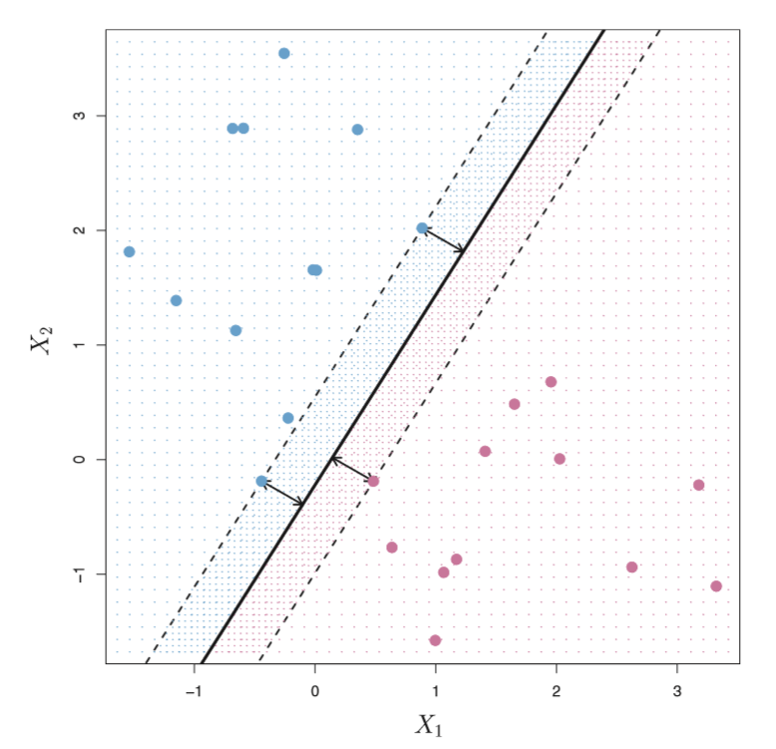
Classiﬁcation Using a Separating Hyperplane

Slide 12
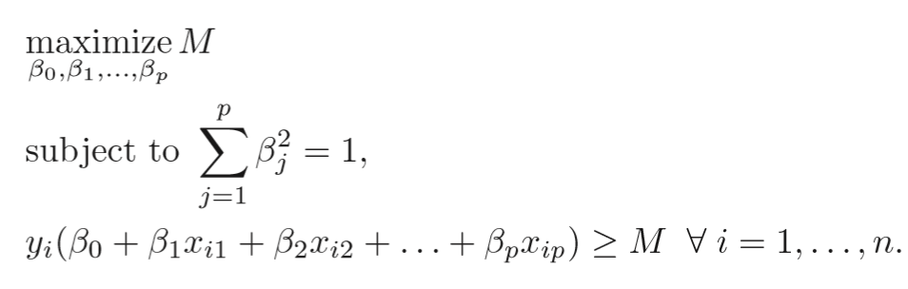
Classiﬁcation Using a Separating Hyperplane
We now consider the task of constructing the maximal margin hyperplane based on a set of n training observations and associated class labels. Brieﬂy, the maximal margin hyperplane is the solution to the optimization problem
This is a quadratic optimization problem subject to linear constraints and there is a unique solution.

Slide 13
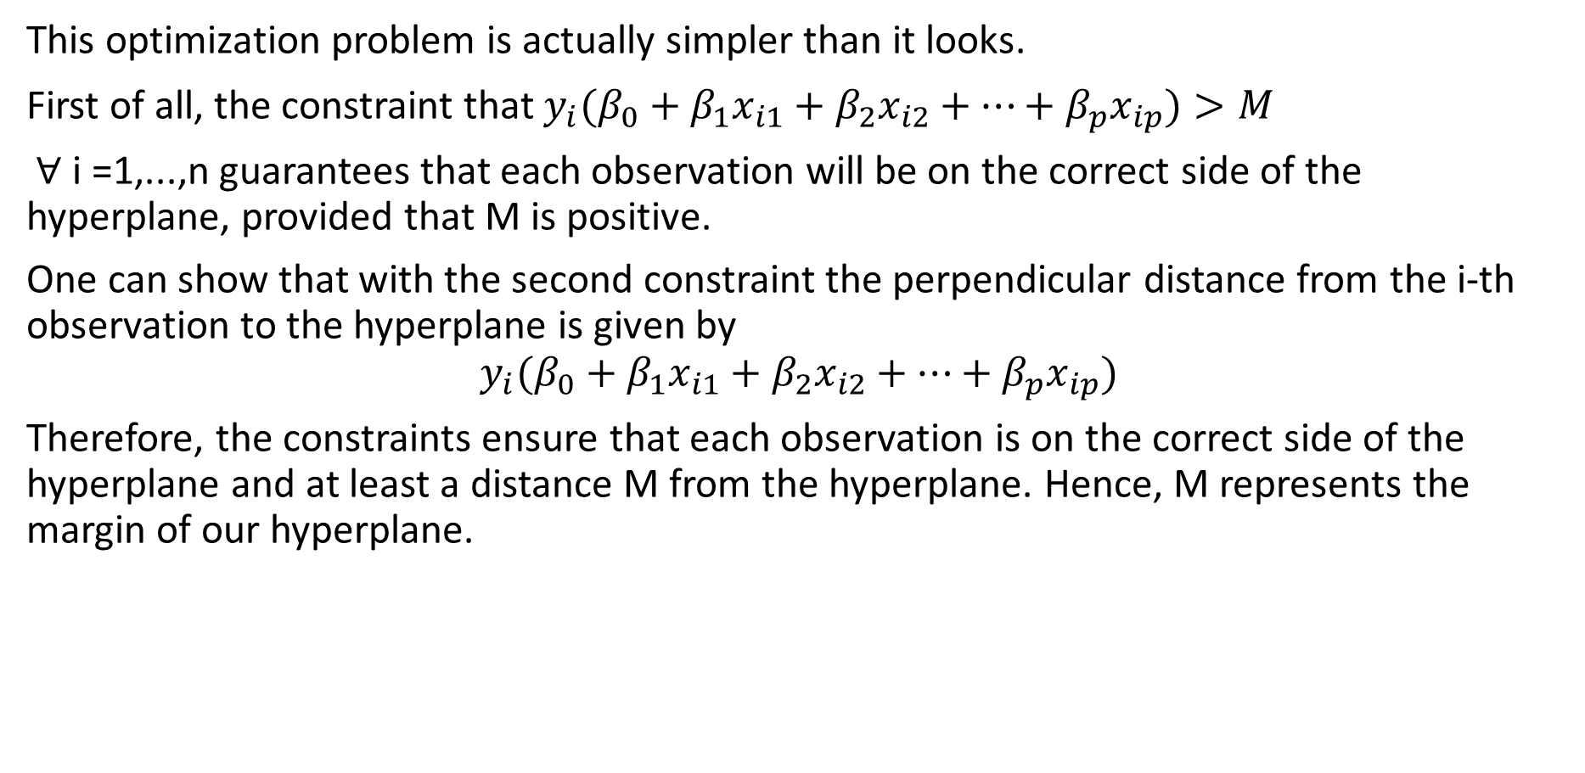
Classiﬁcation Using a Separating Hyperplane
This optimization problem is actually simpler than it looks.
First of all, the constraint that ${y_{i}(β}_{0}+β_{1}x_{i1}+β_{2}x_{i2}+…+β_{p}x_{ip})>M$
∀ i =1,...,n guarantees that each observation will be on the correct side of the hyperplane, provided that M is positive.
One can show that with the second constraint the perpendicular distance from the i-th observation to the hyperplane is given by
$${y_{i}(β}_{0}+β_{1}x_{i1}+β_{2}x_{i2}+…+β_{p}x_{ip})$$
Therefore, the constraints ensure that each observation is on the correct side of the hyperplane and at least a distance M from the hyperplane. Hence, M represents the margin of our hyperplane.

Slide 14
Non-separable case
The maximal margin classiﬁer is a very natural way to perform classiﬁcation, if a separating hyperplane exists. However, in many cases no separating hyperplane exists, and so there is no maximal margin classiﬁer. In this case, the optimization problem has no solution with M>0.
In this case, we cannot exactly separate the two classes. However, we can extend the concept of a separating hyperplane in order to develop a hyperplane that almost separates the classes, using a so-called soft margin. The generalization of the maximal margin classiﬁer to the non-separable case is known as the support vector classiﬁer.

Slide 15
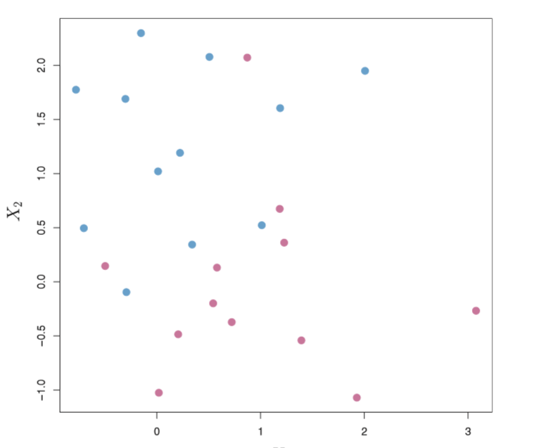
There are two classes of observations, shown in blue and in purple. In this case, the two classes are not separable by a hyperplane, and so the maximal margin classiﬁer cannot be used.
Non-separable case

Slide 16
Classiﬁcation Using a Separating Hyperplane
In fact, even if a separating hyperplane does exist, then there are instances in which a classiﬁer based on a separating hyperplane might not be desirable.
A classiﬁer based on a separating hyperplane will necessarily perfectly classify all of the training observations; this can lead to sensitivity to individual observations. An example is shown in the following figure.
The addition of a single observation leads to a dramatic change in the maximal margin hyperplane. The resulting maximal margin hyperplane is not satisfactory—for one thing, it has only a tiny margin. This is problematic because as discussed previously, the distance of an observation from the hyperplane can be seen as a measure of our conﬁdence that the observation was correctly classiﬁed. Moreover, the fact that the maximal margin hyperplane is extremely sensitive to a change in a single observation suggests that it may have overﬁt the training data.

Slide 17
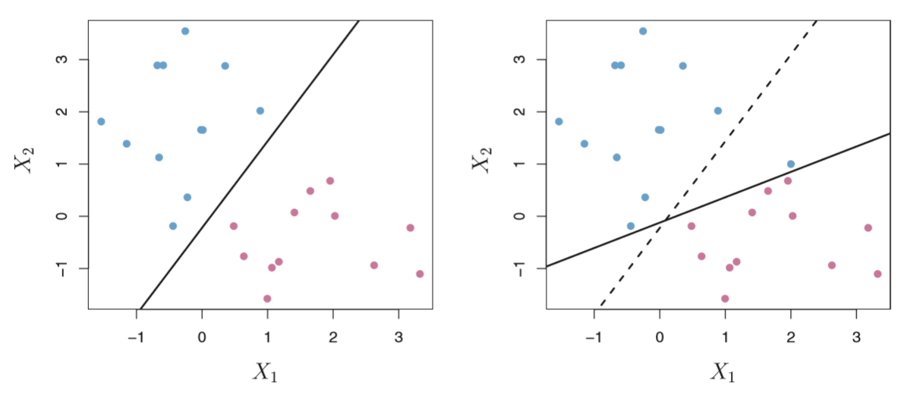
Classiﬁcation Using a Separating Hyperplane
Two classes of observations are shown in blue and in purple, along with the maximal margin hyperplane. Right: An additional blue observation has been added, leading to a dramatic shift in the maximal margin hyperplane shown as a solid line. The dashed line indicates the maximal margin hyperplane that was obtained in the absence of this additional point.

Slide 18
Classiﬁcation Using a Separating Hyperplane
The support vector classiﬁer, sometimes called a soft margin classiﬁer.
Rather than seeking the largest possible margin so that every observation is not only on the correct side of the hyperplane but also on the correct side of the margin, we instead allow some observations to be on the incorrect side of the margin, or even the incorrect side of the hyperplane. (The margin is soft because it can be violated by some of the training observations.)
An example is shown in the the following figure. Most of the observations are on the correct side of the margin. However, a small subset of the observations are on the wrong side of the margin. An observation can be not only on the wrong side of the margin, but also on the wrong side of the hyperplane. In fact, when there is no separating hyperplane, such a situation is inevitable. Observations on the wrong side of the hyperplane correspond to training observations that are misclassiﬁed by the support vector classiﬁer.

Slide 19
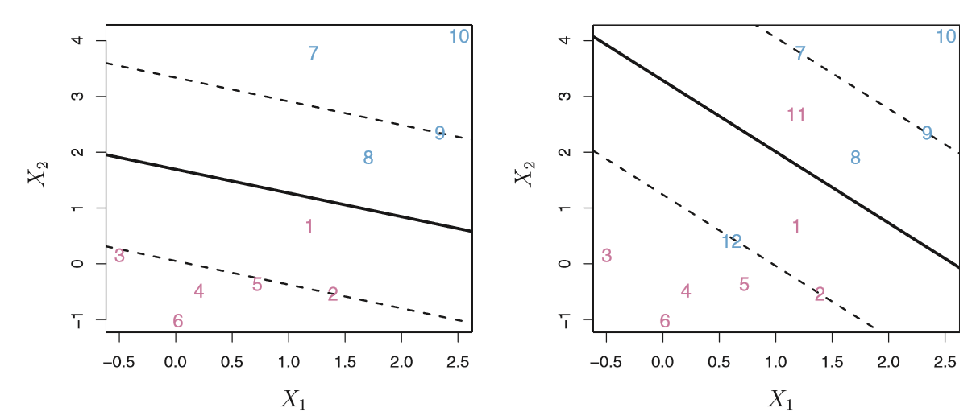
Classiﬁcation Using a Separating Hyperplane
Left: A support vector classiﬁer was ﬁt to a small data set. The hyperplane is shown as a solid line and the margins are shown as dashed lines. Purple observations: Observations 3,4,5, and6 are on the correct side of the margin, observation 2 is on the margin, and observation 1 is on the wrong side of the margin. Blue observations: Observations 7 and 10 are on the correct side of the margin, observation 9 is on the margin, and observation 8 is on the wrong side of the margin. No observations are on the wrong side of the hyperplane. Right: Same as left with two additional points, 11 and 12. These two observations are on the wrong side of the hyperplane and the wrong side of the margin.

Slide 20
Classiﬁcation Using a Separating Hyperplane
In this case, we might be willing to consider a classiﬁer based on a hyperplane that does not perfectly separate the two classes, in the interest of
• Greater robustness to individual observations, and
• Better classiﬁcation of most of the training observations.
That is, it could be worthwhile to misclassify a few training observations in order to do a better job in classifying the remaining observations.

Slide 21
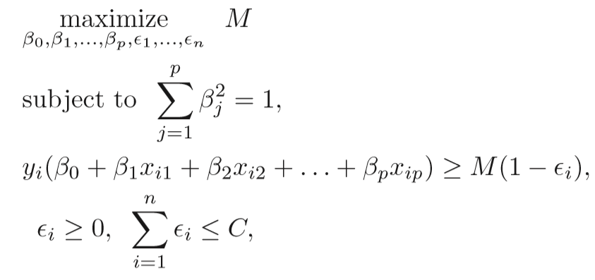

Classiﬁcation Using a Separating Hyperplane
The support vector classiﬁer classiﬁes a test observation depending on which side of a hyperplane it lies. The hyperplane is chosen to correctly separate most of the training observations into the two classes, but may misclassify a few observations. It is the solution to the optimization problem
where C is a nonnegative tuning parameter. M is the width of the margin; we seek to make this quantity as large as possible. $ε_{i}$ are slack variables that allow individual observations to be on the wrong side of the margin or the hyperplane.

Slide 22
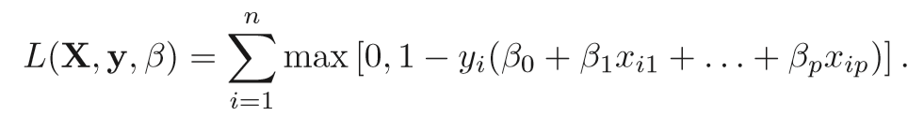
Classiﬁcation Using a Separating Hyperplane
An alternative equivalent formulation is in terms of the minimizing the loss function
Under the same constraints. This is the hinge loss function.

Slide 23
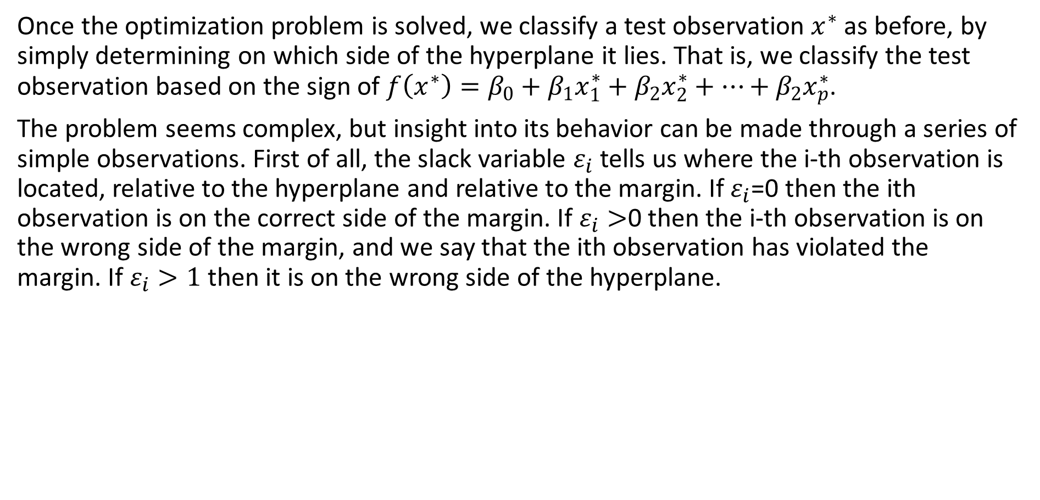
Classiﬁcation Using a Separating Hyperplane
Once the optimization problem is solved, we classify a test observation $x^{∗}$ as before, by simply determining on which side of the hyperplane it lies. That is, we classify the test observation based on the sign of ${f\left(x^{∗}\right)=β}_{0}+β_{1}x_{1}^{∗}+β_{2}x_{2}^{∗}+…+β_{2}x_{p}^{∗}$.
The problem seems complex, but insight into its behavior can be made through a series of simple observations. First of all, the slack variable $ε_{i}$ tells us where the i-th observation is located, relative to the hyperplane and relative to the margin. If $ε_{i}$=0 then the ith observation is on the correct side of the margin. If $ε_{i}>$0 then the i-th observation is on the wrong side of the margin, and we say that the ith observation has violated the margin. If $ε_{i}>1$ then it is on the wrong side of the hyperplane.

Slide 24
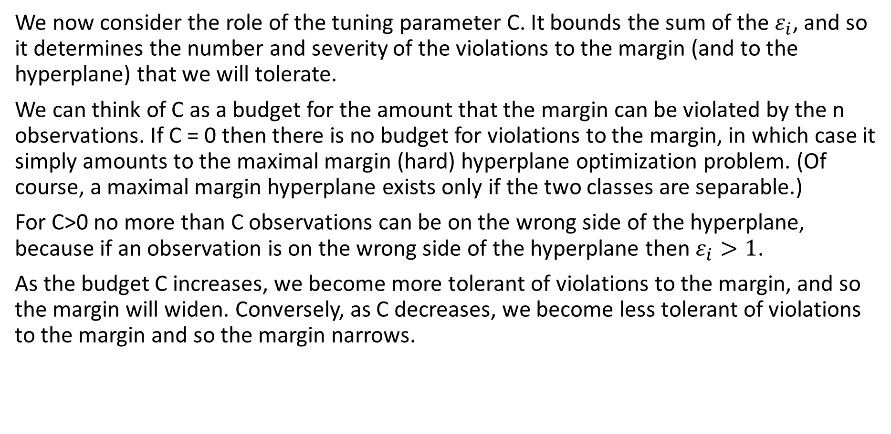
Classiﬁcation Using a Separating Hyperplane
We now consider the role of the tuning parameter C. It bounds the sum of the $ε_{i}$, and so it determines the number and severity of the violations to the margin (and to the hyperplane) that we will tolerate.
We can think of C as a budget for the amount that the margin can be violated by the n observations. If C = 0 then there is no budget for violations to the margin, in which case it simply amounts to the maximal margin (hard) hyperplane optimization problem. (Of course, a maximal margin hyperplane exists only if the two classes are separable.)
For C>0 no more than C observations can be on the wrong side of the hyperplane, because if an observation is on the wrong side of the hyperplane then $ε_{i}>1$.
As the budget C increases, we become more tolerant of violations to the margin, and so the margin will widen. Conversely, as C decreases, we become less tolerant of violations to the margin and so the margin narrows.

Slide 25
Classiﬁcation Using a Separating Hyperplane
In practice, C is treated as a tuning parameter that is generally chosen via cross-validation. As with the tuning parameters, C controls the bias-variance trade-oﬀ of the statistical learning technique. When C is small, we seek narrow margins that are rarely violated; this amounts to a classiﬁer that is highly ﬁt to the data, which may have low bias but high variance. On the other hand, when C is larger, the margin is wider and we allow more violations to it; this amounts to ﬁtting the data less hard and obtaining a classiﬁer that is potentially more biased but may have lower variance.

Slide 26
Classiﬁcation Using a Separating Hyperplane
The soft margin optimization problem has a very interesting property: it turns out that only observations that either lie on the margin or that violate the margin will aﬀect the hyperplane, and hence the classiﬁer obtained.
In other words, an observation that lies strictly on the correct side of the margin does not aﬀect the support vector classiﬁer! Changing the position of that observation would not change the classiﬁer at all, provided that its position remains on the correct side of the margin.
Observations that lie directly on the margin, or on the wrong side of the margin for their class, are called as support vectors. These observations do aﬀect the support vector classiﬁer. The fact that only support vectors aﬀect the classiﬁer is in line with our previous assertion that C controls the bias-variance trade-oﬀ of the support vector classiﬁer. When the tuning parameter C is large, then the margin is wide, many observations violate the margin, and so there are many support vectors. In this case, many observations are involved in determining the hyperplane.

Slide 27
Classiﬁcation Using a Separating Hyperplane
The fact that the support vector classiﬁer’s decision rule is based only on a potentially small subset of the training observations (the support vectors) means that it is quite robust to the behavior of observations that are far away from the hyperplane. This is a very valuable property of SVM.

Slide 28
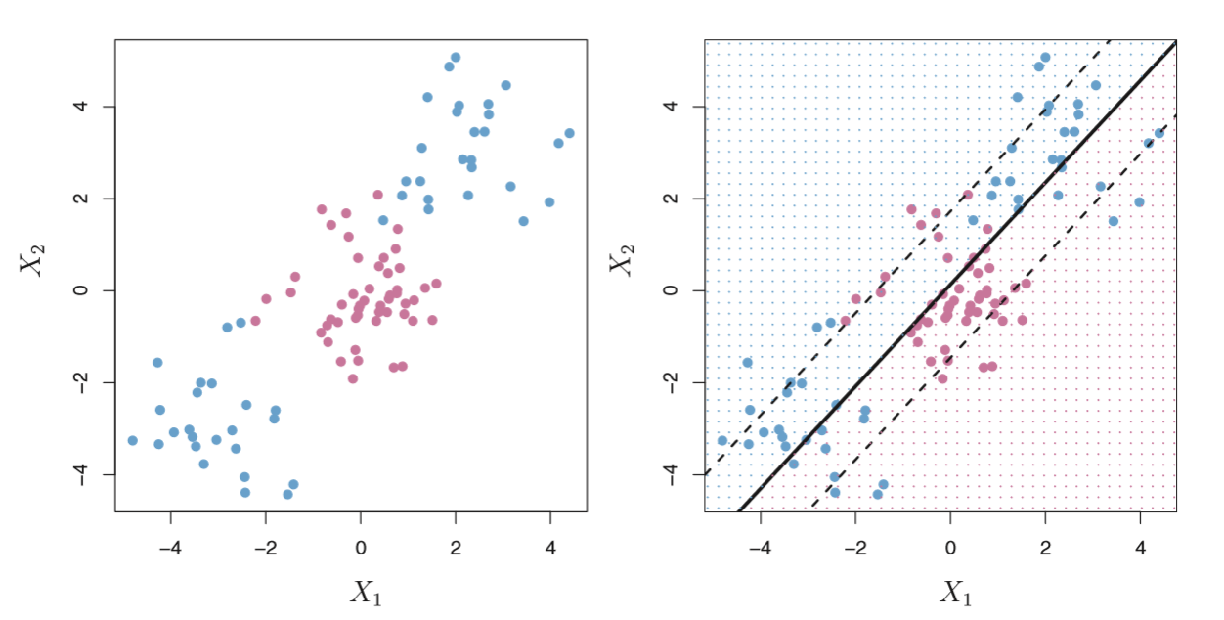
Classiﬁcation Using a Separating Hyperplane
The support vector classiﬁer is a natural approach for classiﬁcation in the two-class setting, if the boundary between the two classes is linear. However, in practice we are sometimes faced with non-linear class boundaries. For instance, consider the data in the figures. It is clear that a support vector classiﬁer or any linear classiﬁer will perform poorly here. Indeed, the support vector classiﬁer shown in the right-hand panel of is useless here.

Slide 29
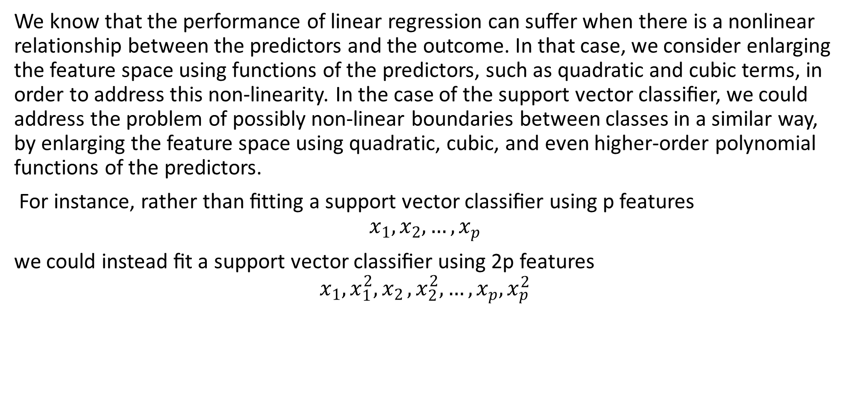
Classiﬁcation Using a Separating Hyperplane
We know that the performance of linear regression can suﬀer when there is a nonlinear relationship between the predictors and the outcome. In that case, we consider enlarging the feature space using functions of the predictors, such as quadratic and cubic terms, in order to address this non-linearity. In the case of the support vector classiﬁer, we could address the problem of possibly non-linear boundaries between classes in a similar way, by enlarging the feature space using quadratic, cubic, and even higher-order polynomial functions of the predictors.
For instance, rather than ﬁtting a support vector classiﬁer using p features
$$x_{1},x_{2},…,x_{p}$$
we could instead ﬁt a support vector classiﬁer using 2p features
$$x_{1},x_{1}^{2}{,x}_{2},x_{2}^{2},…,x_{p},x_{p}^{2}$$

Slide 30

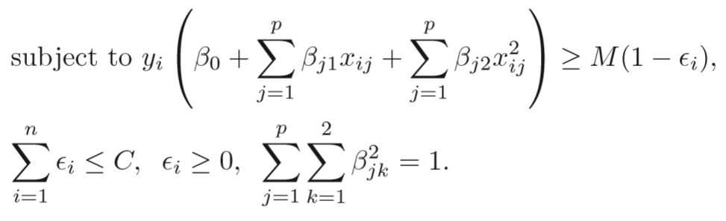
Classiﬁcation Using a Separating Hyperplane
The soft margin classification problem would then become

Slide 31
Classiﬁcation Using a Separating Hyperplane
Why does this lead to a non-linear decision boundary? In the enlarged feature space, the decision boundary that results from is in fact linear. But in the original feature space, the decision boundary is of the form q(x) = 0, where q is a quadratic polynomial, and its solutions are generally non-linear.
One might additionally want to enlarge the feature space with higher-order polynomial terms, or with interaction terms.
Alternatively, other functions of the predictors could be considered rather than polynomials. It is not hard to see that there are many possible ways to enlarge the feature space, and that unless we are careful, we could end up with a huge number of features. Then computations would become unmanageable. The support vector machine allows us to enlarge the feature space used by the support vector classiﬁer in a way that leads to eﬃcient computations.

Slide 32
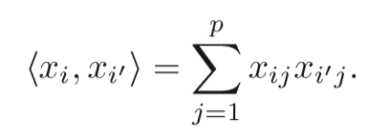
Classiﬁcation Using a Separating Hyperplane
The capabilities of the support vector machine (SVM) can be extended enlarging the feature space in a speciﬁc way, using kernels.
The kernel approach is simply an eﬃcient computational approach for enacting this idea. It turns out that the solution to the support vector classiﬁer problem involves only the inner products of the observations (as opposed to the observations themselves).
The inner (dot) product of two observations is

Slide 33
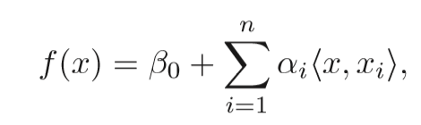

Classiﬁcation Using a Separating Hyperplane
It can be shown that the linear support vector classiﬁer can be represented as
where there are n parameters $α_{1},α_{2},…,α_{n}$, one per training observation.
To estimate the parameters $α_{i}$ and $β_{0}$, all we need $\frac{n(n−1)}{2}$ inner products.

Slide 34
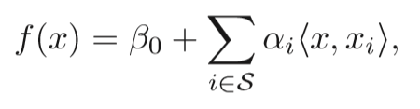
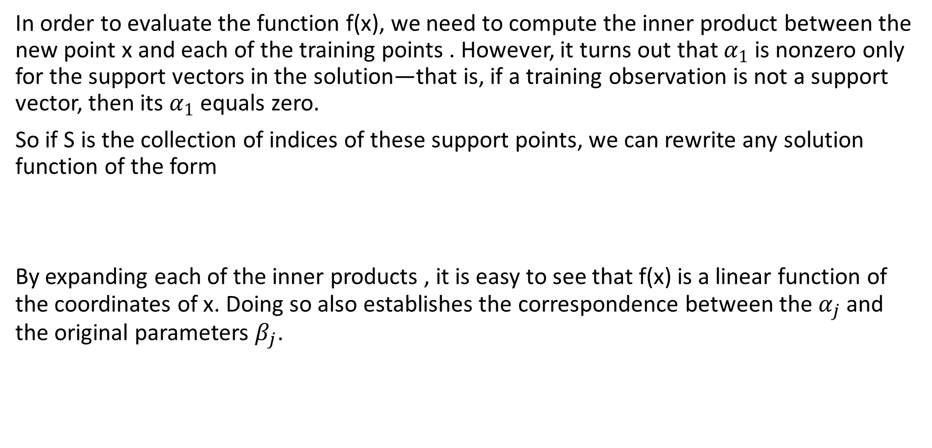
Classiﬁcation Using a Separating Hyperplane
In order to evaluate the function f(x), we need to compute the inner product between the new point x and each of the training points . However, it turns out that $α_{1}$ is nonzero only for the support vectors in the solution—that is, if a training observation is not a support vector, then its $α_{1}$ equals zero.
So if S is the collection of indices of these support points, we can rewrite any solution function of the form
By expanding each of the inner products , it is easy to see that f(x) is a linear function of the coordinates of x. Doing so also establishes the correspondence between the $α_{j}$ and the original parameters $β_{j}$.

Slide 35

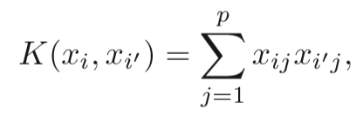
Classiﬁcation Using a Separating Hyperplane
To summarize, in representing the linear classiﬁer f(x), and in computing its coeﬃcients, all we need are inner products.
Now suppose that every time the inner product appears in a calculation of the solution for the support vector classiﬁer, we replace it with a generalization of the inner product of the form
where K is some function that we will refer to as a kernel. A kernel is a function that quantiﬁes the similarity of two observations. For instance, we could simply take
which would just give us back the original support vector classiﬁer. This equation is known as a linear kernel because the support vector classiﬁer is linear in the features; it essentially quantiﬁes the similarity of a pair of observations using Pearson (standard) correlation.

Slide 36
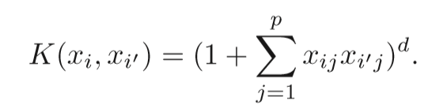
Classiﬁcation Using a Separating Hyperplane
We can use some other forms of kernel functions. For example
This is known as a polynomial kernel of degree d, where d is a positive polynomial kernel integer.
Using such a kernel with d>1, instead of the standard linear kernel, in the support vector classiﬁer algorithm leads to a much more ﬂexible decision boundary. It essentially amounts to ﬁtting a support vector classiﬁer in a higher-dimensional space involving polynomials of degree d, rather than in the original feature space. When the support vector classiﬁer is combined with a non-linear kernel, the resulting classiﬁer is known as a support vector machine.

Slide 37
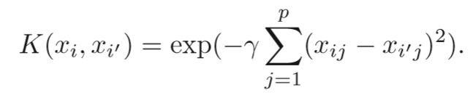
Classiﬁcation Using a Separating Hyperplane
Another popular choice is the radial kernel (aka rbf or Gaussian), which takes the form
where γ is a positive constant. The figures on the next slide show an example of an SVM with a radial kernel on this non-linear data; it also does a good job in separating the two classes.
Because of the exponential decay the radial kernel has very local behavior, in the sense that only nearby training observations have an eﬀect on the class label of a test observation.

Slide 38
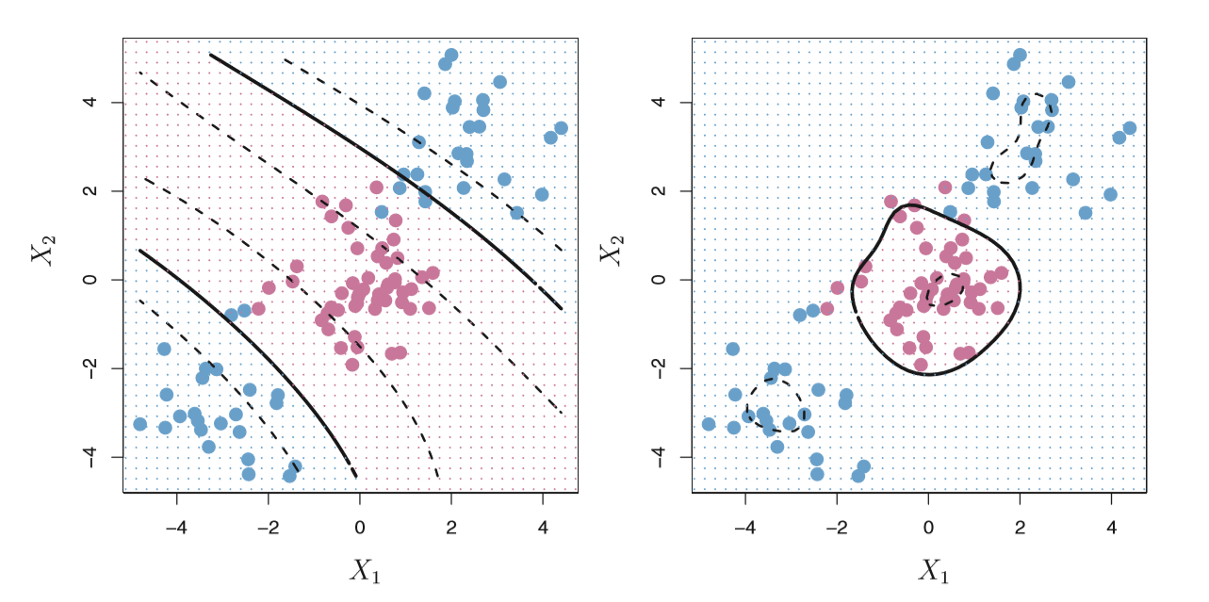
Classiﬁcation Using a Separating Hyperplane
Left: An SVM with a polynomial kernel of degree 3 is applied
Right: An SVM with a radial kernel is applied.
In this example, either kernel is capable of capturing the decision boundary.

Slide 39
Trained Model Parameters in Matlab
Alpha — Trained classifier coefficients numeric vector
This property is read-only.
Trained classifier coefficients, specified as an s-by-1 numeric vector. s is the number of support vectors in the trained classifier, sum(Mdl.IsSupportVector).
Alpha contains the trained classifier coefficients from the dual problem, that is, the estimated Lagrange multipliers. Data Types: single | double

Slide 40
Trained Model Parameters in Matlab
Beta — Linear predictor coefficients numeric vector
This property is read-only.
Linear predictor coefficients, specified as a numeric vector. The length of Beta is equal to the number of predictors used to train the model.
If KernelParameters.Function is not 'linear', then Beta is empty ([]).
Data Types: single | double

Slide 41
Trained Model Parameters in Matlab
Bias — Bias term
scalar
This property is read-only.
Bias term, specified as a scalar.
BoxConstraints — Box constraints
numeric vector
This property is read-only.
Box constraints, specified as a numeric vector of n-by-1 box constraints. n is the number of observations in the training data (see the NumObservations property).

Slide 42
Trained Model Parameters in Matlab
KernelParameters — Kernel parameters
structure array
This property is read-only.
Kernel parameters, specified as a structure array. The kernel parameters property contains the fields listed in this table.

Slide 43
Trained Model Parameters in Matlab
SupportVectorLabels — Support vector class labels
s-by-1 numeric vector
This property is read-only.
Support vector class labels, specified as an s-by-1 numeric vector. s is the number of support vectors in the trained classifier, sum(Mdl.IsSupportVector).
A value of +1 in SupportVectorLabels indicates that the corresponding support vector is in the positive class (ClassNames{2}). A value of –1 indicates that the corresponding support vector is in the negative class (ClassNames{1}).

Slide 44
Trained Model Parameters in Matlab
SupportVectors — Support vectors
s-by-p numeric matrix
This property is read-only.
Support vectors in the trained classifier, specified as an s-by-p numeric matrix. s is the number of support vectors in the trained classifier, sum(Mdl.IsSupportVector), and p is the number of predictor variables in the predictor data.
SupportVectors contains rows of the predictor data X that MATLAB considers to be support vectors. If you specify 'Standardize',true when training the SVM classifier using fitcsvm, then SupportVectors contains the standardized rows of X.

Slide 45
Trained Model Parameters in Matlab
Mu — Predictor means
numeric vector | []
This property is read-only.
Predictor means, specified as a numeric vector. If you specify 'Standardize',1 or 'Standardize',true when you train an SVM classifier using fitcsvm, then the length of Mu is equal to the number of predictors.
If you set 'Standardize',false when you train the SVM classifier using fitcsvm, then Mu is an empty vector ([]).

Slide 46
Trained Model Parameters in Matlab
NumObservations — Number of observations
numeric scalar
This property is read-only.
Number of observations in the training data stored in X and Y, specified as a numeric scalar.
PredictorNames — Predictor variable names
cell array of character vectors
This property is read-only.
Predictor variable names, specified as a cell array of character vectors. The order of the elements of PredictorNames corresponds to the order in which the predictor names appear in the training data.

Slide 47
Trained Model Parameters in Matlab
Prior — Prior probabilities
numeric vector
This property is read-only.
Prior probabilities for each class, specified as a numeric vector. The order of the elements of Prior corresponds to the elements of Mdl.ClassNames.
For two-class learning, if you specify a cost matrix, then the software updates the prior probabilities by incorporating the penalties described in the cost matrix.
For more details, see Algorithms.

Slide 48
Trained Model Parameters in Matlab
ResponseName — Response variable name
character vector
This property is read-only.
Response variable name, specified as a character vector.

Slide 49
Trained Model Parameters in Matlab
Sigma — Predictor standard deviations
[] (default) | numeric vector
This property is read-only.
Predictor standard deviations, specified as a numeric vector.
If you specify 'Standardize',true when you train the SVM classifier using fitcsvm, then the length of Sigma is equal to the number of predictor variables.
If you set 'Standardize',false when you train the SVM classifier using fitcsvm, then Sigma is an empty vector ([]).

Slide 50
Trained Model Parameters in Matlab
Y — Class labels
categorical array | character array | logical vector | numeric vector | cell array of character vectors
This property is read-only.
Class labels used to train the SVM classifier, specified as a categorical or character array, logical or numeric vector, or cell array of character vectors. Y is the same data type as the input argument Y of fitcsvm. (The software treats string arrays as cell arrays of character vectors.)
Each row of Y represents the observed classification of the corresponding row of X.
MATLAB excludes elements containing missing values, and removes corresponding observations from X.

Slide 51
Classifying New Data with an SVM Classifier
Classify new data using predict. The syntax for classifying new data using a trained SVM classifier (SVMModel) is:
[label,score] = predict(SVMModel,newX);
The resulting vector, label, represents the classification of each row in X. score is an n-by-2 matrix of soft scores. Each row corresponds to a row in X, which is a new observation. The first column contains the scores for the observations being classified in the negative class, and the second column contains the scores observations being classified in the positive class.
To estimate posterior probabilities rather than scores, first pass the trained SVM classifier (SVMModel) to fitPosterior, which fits a score-to-posterior-probability transformation function to the scores. The syntax is:
ScoreSVMModel = fitPosterior(SVMModel,X,Y);
The property ScoreTransform of the classifier ScoreSVMModel contains the optimal transformation function. Pass ScoreSVMModel to predict. Rather than returning the scores, the output argument score contains the posterior probabilities of an observation being classified in the negative (column 1 of score) or positive (column 2 of score) class.

Slide 52
The software fits the appropriate score-to-posterior-probability transformation function by using the SVM classifier SVMModel and by conducting 10-fold cross-validation using the stored predictor data (SVMModel.X) and the class labels (SVMModel.Y), as outlined in. The transformation function computes the posterior probability that an observation is classified into the positive class.
If the classes are inseparable, then the transformation function is the sigmoid function.
If the classes are perfectly separable, then the transformation function is the step function.
In two-class learning, if one of the two classes has a relative frequency of 0, then the transformation function is the constant function. The fitPosterior function is not appropriate for one-class learning.
The software stores the optimal score-to-posterior-probability transformation function in ScoreSVMModel.ScoreTransform.
If you re-estimate the score-to-posterior-probability transformation function, that is, if you pass an SVM classifier to fitPosterior or fitSVMPosterior and its ScoreTransform property is not none, then the software:
Displays a warning
Resets the original transformation function to 'none' before estimating the new one

